Slide 1
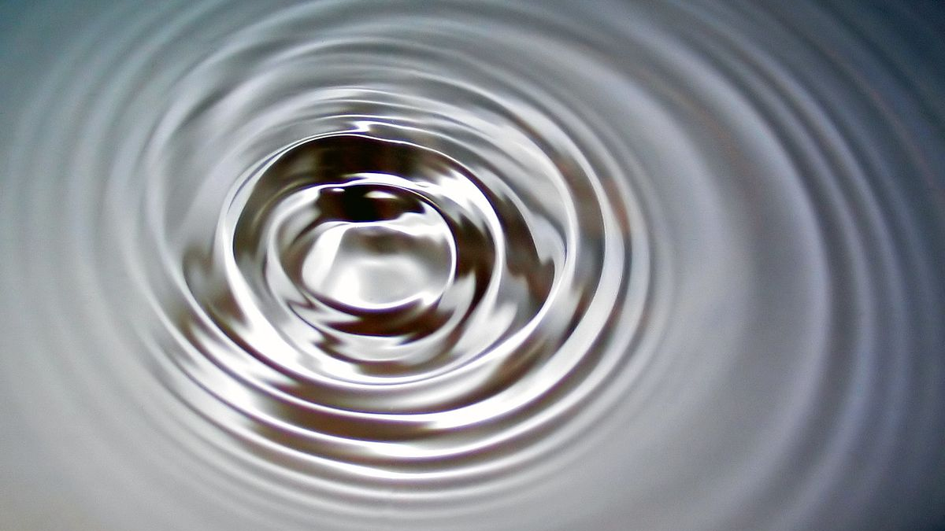
Oscillations and Waves (Part 3)
Electrical Oscillators
Dr. Sourav Marik
Assistant Professor, TIET, Patiala

Slide 2






Energy of a simple pendulum
$$θ$$
$$L$$
$$L$$
$$m$$

Slide 3
Electrical Oscillators: LC Circuit

Slide 4
Electrical Oscillators: LC Circuit
Oscillations in electrical circuits: similarities

Slide 5
Electrical Oscillators: LC Circuit
Oscillations in electrical circuits: similarities
+Q
C
L
-Q
I

Slide 6
Electrical Oscillators: LC Circuit
Oscillations in electrical circuits: similarities
When a capacitor is connected to an inductor the combination is an LC circuit
+Q
C
L
-Q
I

Slide 7

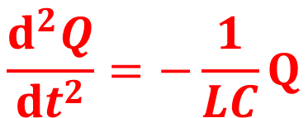


Electrical Oscillators: LC Circuit
Oscillations in electrical circuits: similarities
When a capacitor is connected to an inductor the combination is an LC circuit
The Eqn. of voltage due to the instantaneous current I can be written as;
+Q
$$\frac{Q}{c}+L\frac{ⅆI}{ⅆt}=0$$
$$I=\frac{ⅆQ}{ⅆt}$$
C
L
-Q
$$\frac{Q}{c}+L\frac{ⅆ^{2}Q}{ⅆt^{2}}=0$$
I
$$\frac{ⅆ^{2}Q}{ⅆt^{2}}=−\frac{1}{LC}Q$$

Slide 8

Electrical Oscillators: LC Circuit
Oscillations in electrical circuits: similarities
When a capacitor is connected to an inductor the combination is an LC circuit
The Eqn. of voltage due to the instantaneous current I can be written as;
+Q
$$\frac{Q}{c}+L\frac{ⅆI}{ⅆt}=0$$
$$I=\frac{ⅆQ}{ⅆt}$$
C
L
-Q
$$\frac{Q}{c}+L\frac{ⅆ^{2}Q}{ⅆt^{2}}=0$$
I
$$\frac{ⅆ^{2}Q}{ⅆt^{2}}=−\frac{1}{LC}Q$$
$$ω^{2}$$

Slide 9

Electrical Oscillators: LC Circuit
Oscillations in electrical circuits: similarities
When a capacitor is connected to an inductor the combination is an LC circuit
The Eqn. of voltage due to the instantaneous current I can be written as;
+Q
$$\frac{Q}{c}+L\frac{ⅆI}{ⅆt}=0$$
$$I=\frac{ⅆQ}{ⅆt}$$
+Q
C
L
-Q
$$\frac{Q}{c}+L\frac{ⅆ^{2}Q}{ⅆt^{2}}=0$$
I
$$\frac{ⅆ^{2}Q}{ⅆt^{2}}=−\frac{1}{LC}Q$$
Solution
$Q=Q_{max}c$os(ωt+φ)
$$ω^{2}$$

Slide 10
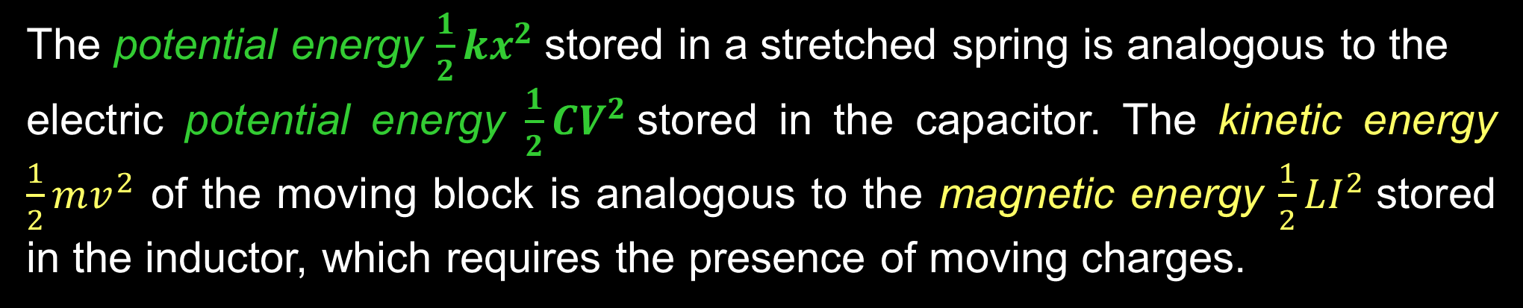

Energy in Electrical Oscillators: LC Circuit
$$E=K+U$$
The potential energy $\frac{1}{2}kx^{2}$stored in a stretched spring is analogous to the
electric potential energy $\frac{1}{2}CV^{2}$stored in the capacitor. The kinetic energy $\frac{1}{2}mv^{2}$ of the moving block is analogous to the magnetic energy $\frac{1}{2}LI^{2}$stored in the inductor, which requires the presence of moving charges.

Slide 11
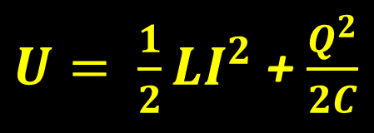
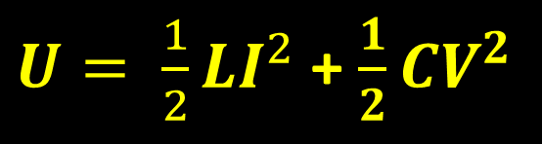
Energy in Electrical Oscillators: LC Circuit
$$E=K+U$$
The potential energy $\frac{1}{2}kx^{2}$stored in a stretched spring is analogous to the
electric potential energy $\frac{1}{2}CV^{2}$stored in the capacitor. The kinetic energy $\frac{1}{2}mv^{2}$ of the moving block is analogous to the magnetic energy $\frac{1}{2}LI^{2}$stored in the inductor, which requires the presence of moving charges.
$U= \frac{1}{2}LI^{2}$ + $\frac{1}{2}CV^{2}$
$U= \frac{1}{2}LI^{2}$ + $\frac{Q^{2}}{2C}$

Slide 12
Energy in Electrical Oscillators: LC Circuit
$$E=K+U$$
The potential energy $\frac{1}{2}kx^{2}$stored in a stretched spring is analogous to the
electric potential energy $\frac{1}{2}CV^{2}$stored in the capacitor. The kinetic energy $\frac{1}{2}mv^{2}$ of the moving block is analogous to the magnetic energy $\frac{1}{2}LI^{2}$stored in the inductor, which requires the presence of moving charges.
$U= \frac{1}{2}LI^{2}$ + $\frac{1}{2}CV^{2}$
$U= \frac{1}{2}LI^{2}$ + $\frac{Q^{2}}{2C}$
Assumed the circuit resistance to be zero, so no energy is transformed to internal energy and none is transferred out of the system of the circuit. Therefore, the total energy of the system must remain constant in time.

Slide 13
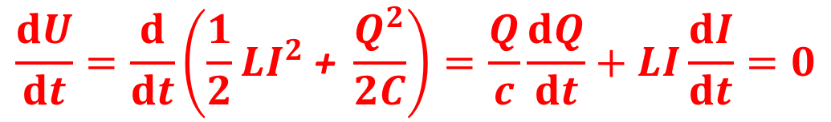
Energy in Electrical Oscillators: LC Circuit
$$E=K+U$$
The potential energy $\frac{1}{2}kx^{2}$stored in a stretched spring is analogous to the
electric potential energy $\frac{1}{2}CV^{2}$stored in the capacitor. The kinetic energy $\frac{1}{2}mv^{2}$ of the moving block is analogous to the magnetic energy $\frac{1}{2}LI^{2}$stored in the inductor, which requires the presence of moving charges.
$U= \frac{1}{2}LI^{2}$ + $\frac{1}{2}CV^{2}$
$U= \frac{1}{2}LI^{2}$ + $\frac{Q^{2}}{2C}$
Assumed the circuit resistance to be zero, so no energy is transformed to internal energy and none is transferred out of the system of the circuit. Therefore, the total energy of the system must remain constant in time.
$$\frac{ⅆU}{ⅆt}=\frac{ⅆ}{ⅆt}\left(\frac{1}{2}LI^{2}\text{ + }\frac{Q^{2}}{2C}\right)=\frac{Q}{c}\frac{ⅆQ}{ⅆt}+LI\frac{ⅆI}{ⅆt}=0$$

Slide 14
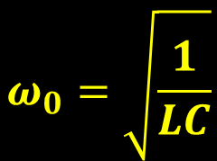
Energy in Electrical Oscillators: LC Circuit
An LC circuit, oscillating at its natural resonant frequency, can store electrical energy. A capacitor stores energy in the electric field (E) between its plates, depending on the voltage across it, and an inductor stores energy in its magnetic field (B), depending on the current through it.
Resonance - applications in signal processing and communications systems.
Resonance occurs when an LC circuit is driven from an external source at an angular frequency ω₀ at which the inductive and capacitive reactance's are equal in magnitude. The frequency at which this equality holds for the particular circuit is called the resonant frequency. The resonant frequency of the LC circuit is
$$ω_{0}=\sqrt{\frac{1}{LC}}$$
Ref. Wikipedia

Slide 15
Energy in Electrical Oscillators: LC Circuit
Oscillations in electrical circuits: similarities with mechanical oscillations

Slide 16





Energy in Electrical Oscillators: LC Circuit
Oscillations in electrical circuits: similarities with mechanical oscillations
x = A
+ $Q_{max}$
t = 0
C
E
L
v =0
- $Q_{max}$
I = 0
x = 0
t = T/4
v = - v_{max}
C
Q = 0
L
I = $I_{max}$
B
- $Q_{max}$
t = T/2
C
E
L
+ $Q_{max}$
v =0
I = 0
x = -A

Slide 17







Energy in Electrical Oscillators: LC Circuit
Oscillations in electrical circuits: similarities with mechanical oscillations
$$Q$$
x = A
$$T$$
+ $Q_{max}$
t = 0
v =0
$$\text{Q}\text{max}$$
C
E
L
$$\frac{T}{2}$$
- $Q_{max}$
I = 0
$$t$$
x = 0
$$I$$
I_{max}
t = T/4
v = - v_{max}
C
Q = 0
L
$$t$$
I = $I_{max}$
B
- $Q_{max}$
t = T/2
C
E
L
+ $Q_{max}$
v =0
I = 0
x = -A

Slide 18
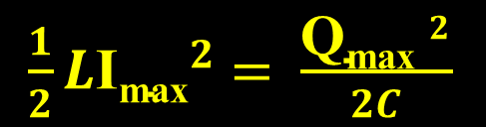
Energy in Electrical Oscillators: LC Circuit
Oscillations in electrical circuits: similarities with mechanical oscillations
$$Q$$
x = A
$$T$$
+ $Q_{max}$
t = 0
v =0
$$\text{Q}\text{max}$$
C
E
L
$$\frac{T}{2}$$
- $Q_{max}$
I = 0
$$t$$
x = 0
$$I$$
I_{max}
t = T/4
v = - v_{max}
C
Q = 0
L
$$t$$
I = $I_{max}$
B
- $Q_{max}$
t = T/2
C
E
L
$\frac{1}{2}L{\text{I}\text{max}}^{2}$ $=$ $\frac{{\text{Q}\text{max} }^{2}}{2C}$
+ $Q_{max}$
v =0
I = 0
x = -A

Slide 19












Energy in Electrical Oscillators: LC Circuit
Oscillations in electrical circuits: similarities with mechanical oscillations
t = ¾ T
v = - v_{max}
$$U_{L}$$
C
Q = 0
L
I = $I_{max}$
B
$$\frac{1}{2}L{\text{I}\text{max}}^{2}$$
$$t$$
x = A
$$t$$
+ $Q_{max}$
t = T
$$\frac{T}{2}$$
$$T$$
C
E
L
v =0
$$U_{C}$$
- $Q_{max}$
I = 0
x = 0
$$\frac{{\text{Q}\text{max} }^{2}}{2C}$$
$$t$$
$$t$$

Slide 20
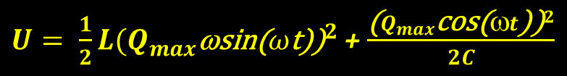
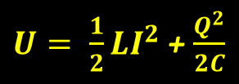


Energy in Electrical Oscillators: LC Circuit
Oscillations in electrical circuits: similarities with mechanical oscillations
t = ¾ T
v = - v_{max}
$$U_{L}$$
C
Q = 0
L
I = $I_{max}$
B
$$\frac{1}{2}L{\text{I}\text{max}}^{2}$$
$$t$$
x = A
$$t$$
+ $Q_{max}$
t = T
$$\frac{T}{2}$$
$$T$$
C
E
L
v =0
$$U_{C}$$
- $Q_{max}$
I = 0
x = 0
$U= \frac{1}{2}LI^{2}$ + $\frac{Q^{2}}{2C}$
$$\frac{{\text{Q}\text{max} }^{2}}{2C}$$
$Q=Q_{max}c$os(ωt) and I = dQ/dt = $Q_{max}\text{ω}$sin(ωt)
$$t$$
$U= \frac{1}{2}L{{(Q}_{max}\text{ω}\text{sin}\text{(}ω\text{t}\text{)}\text{)}}^{2}$ + $\frac{{{\text{(}Q}_{max}\text{co}\text{s}\text{(}ωt\text{)}\text{)}}^{2}}{2C}$
$$ω=\frac{1}{\sqrt{Lc}}$$
$$t$$
$$U=\frac{{Q_{max}}^{2}}{2c}\left(\sin^{2}{ωt}+\cos^{2}{ωt}\right)=\frac{{Q_{max}}^{2}}{2c}$$

Slide 21





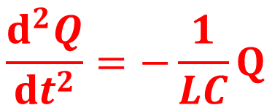




Summary
Oscillations in electrical circuits: similarities with mechanical oscillations
v = - v_{max}
$$U_{L}$$
t = T
C
Q = 0
L
x = 0
$$\frac{1}{2}L{\text{I}\text{max}}^{2}$$
I = $I_{max}$
B
$$t$$
$\frac{ⅆ^{2}x}{ⅆt^{2}}=−\frac{k}{m}x$
$$t$$
$$\frac{ⅆ^{2}Q}{ⅆt^{2}}=−\frac{1}{LC}Q$$
$$\frac{T}{2}$$
$$T$$
$$U_{C}$$
$$\frac{{\text{Q}\text{max} }^{2}}{2C}$$
$$ω^{2}$$
$$ω^{2}$$
$$t$$
Solution
Solution
$$t$$
$Q=Q_{max}c$os(ωt+φ)
x (t) =A cos (ωt+Φ)

Slide 22

Summary
Oscillations in electrical circuits: similarities with mechanical oscillations
v = - v_{max}
t = T
C
Q = 0
L
I = $I_{max}$
B
x = 0

